Slide 1
RESOLVE-IT : SMART GRIEVANCE AND FEEDBACK MANAGEMENT SYSTEM FOR PUBLIC TRANSPORT SERVICES
Presented By:
M Sri Thanvi Reddy
Umme Aiman
Sumayya Tarannum
Atharva Mandgaonkar

Slide 2
INTRODUCTION
It is designed specifically for public transport services. It allows passengers to easily report problems such as bus delays, cleanliness issues, overcrowding, or staff behaviour through a digital platform.
The system helps transport authorities automatically receive, assign, track and resolve complaints faster, while keeping passengers informed with status updates and improving overall service quality.

Slide 3
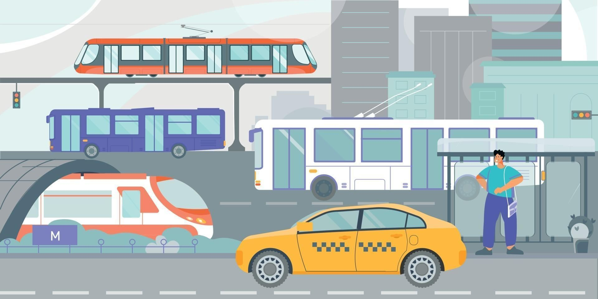
PROBLEM STATEMENTS
Passengers have no proper platform to register complaints easily.
Complaints are handled manually and get delayed or lost.
There is no transparent way to track complaint status.
Authorities do not get clear reports to improve transport services.

Slide 4
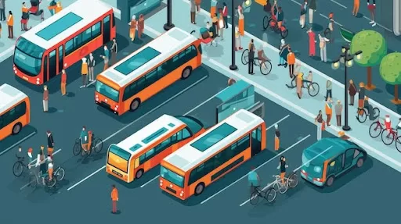
EXISTING SYSTEM
Manual feedback at ticket counters
Suggestion / complaint boxes
Helpline calls
Social media complaints
Emails / basic online forms
PROPOSED SYSTEM
Passengers submit complaints through a digital system
Issues are auto-categorized and sent to the right department
Real-time tracking and notifications are provided
Authorities monitor and resolve complaints using a dashboard

Slide 5
FEATURES
Online complaint and feedback submission
Category selection (delay, cleanliness, staff, ticketing, safety)
Automatic assignment to concerned department
Real-time status tracking
Notifications to passengers
Admin dashboard and reports

Slide 6
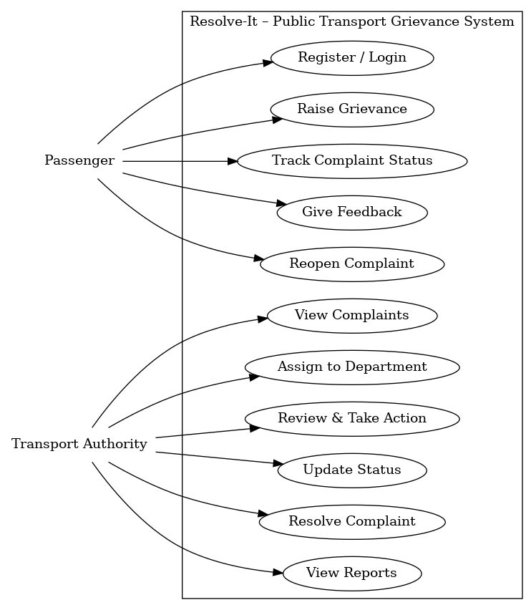
USE CASE DIAGRAM
The Passenger can register or login, raise a grievance, track the complaint, give feedback and reopen the complaint if needed.
The Transport Authority can view complaints, assign them to departments, review and take action, update status, resolve issues and view reports.

Slide 7
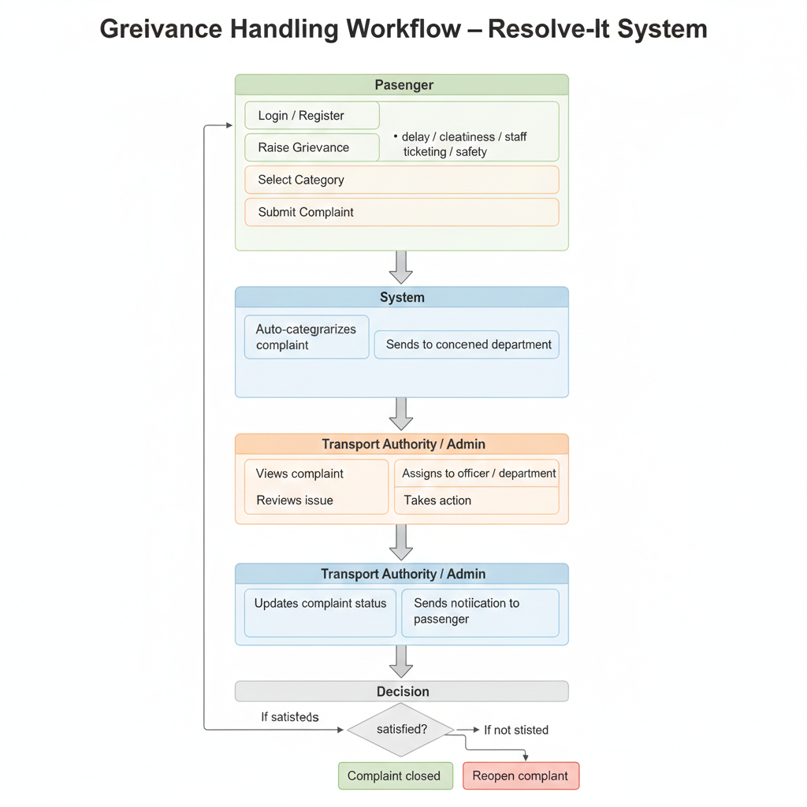
WORKING FLOW
Passenger logs in and raises a grievance.
The system categorizes and sends it to the concerned department.
Admin reviews the complaint and takes action.
Status is updated and notification is sent to the passenger.
If the passenger is satisfied, the complaint is closed.
If not satisfied, the complaint is reopened.

Slide 8
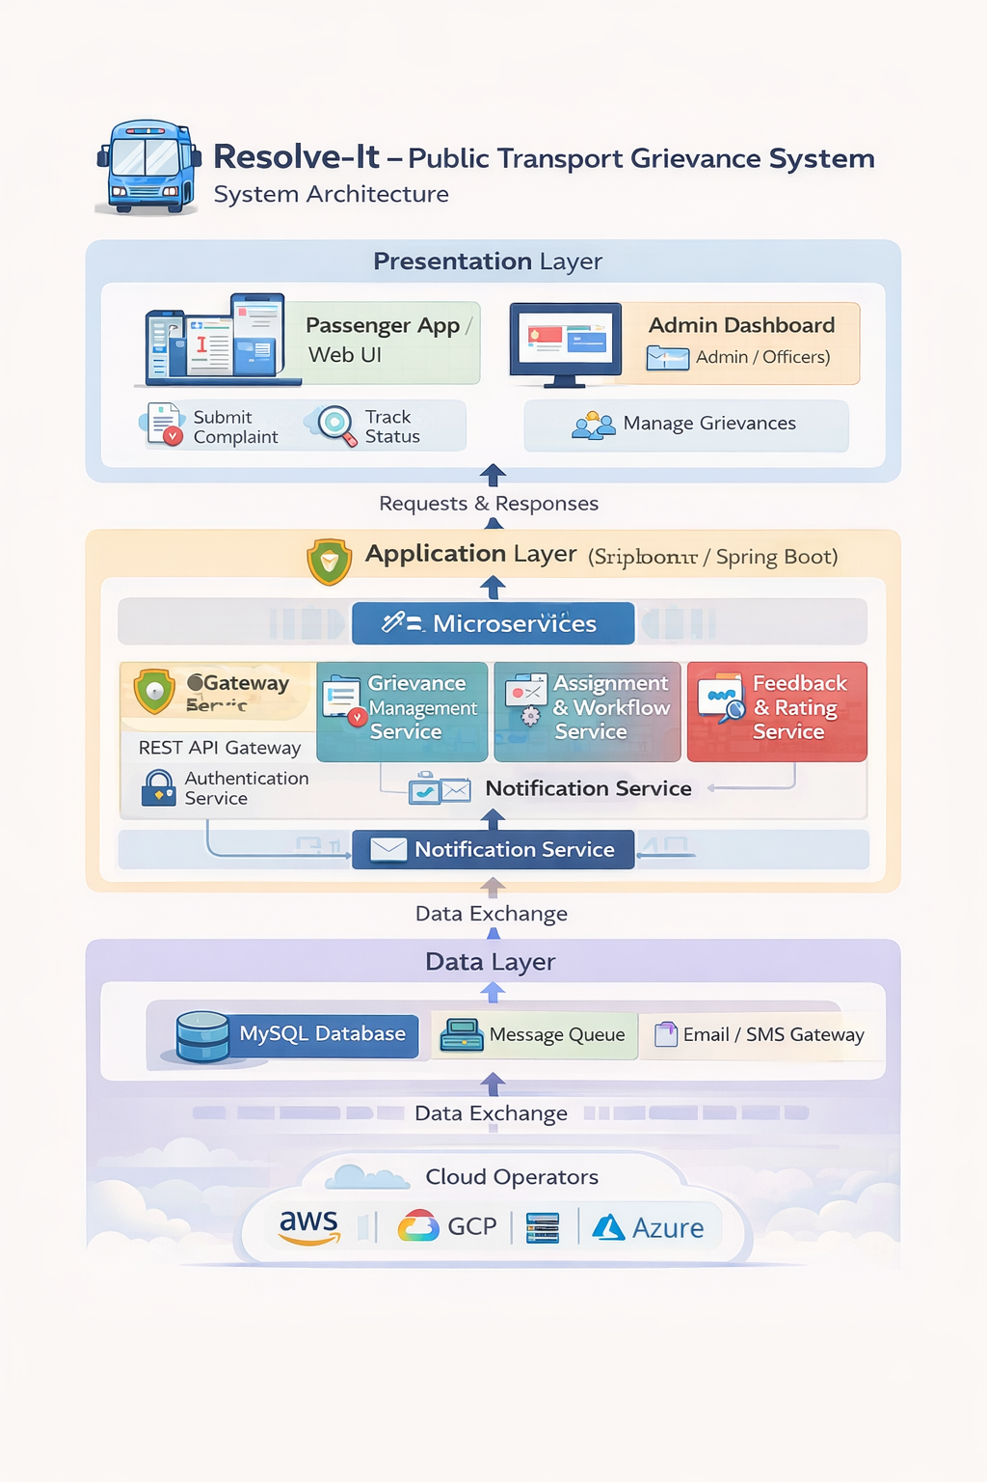
SYSTEM ARCHITECTURE
Presentation layer – App and dashboard for users and admins.
Application layer – Services process complaints and workflows.
Data layer – Stores data and sends notifications.

Slide 9

TOOLS USED
Frontend: HTML, CSS, JavaScript
Backend: Java, Spring Boot
Database: MySQL
Development Tool (IDE): Eclipse / IntelliJ
Version Control: Git

Slide 10
CONCLUSION
Resolve-It helps passengers easily report public transport issues and track their complaints transparently. It improves service quality by enabling authorities to resolve problems faster and more efficiently.

Slide 11
THANK YOU

